Slide 1



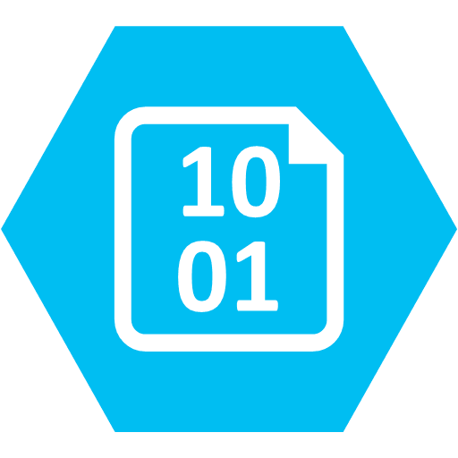

Lab Architecture
MODEL TRAINING
MODEL MANAGEMENT
AUTO ML
Azure ML Training Compute
Track Runs & Register Models
Azure ML Workspace
Register Automated Machine Learning Model
Azure ML Workspace
INGEST
LONG TERM STORAGE
STREAM DATA PROCESSING
Retrieve Model
IoT Hub or Event Hubs
Azure Storage
Battery Telemetry
Azure Databricks (Spark Structured Streaming)
Simulated Data Stream
(NOTE: not used in the lab)
(NOTE: a CSV file of previously captured streaming data is provided to expedite setup)
BATCH DATA PROCESSING
Component Text
Azure Databricks (Spark DataFrames)

